Slide 1



Research shows that therapy for aphasia does work
Research
(Brady et al., 2016)
Note this was an earlier draft and varies slightly from the final video abstract. Some slides have too many words in the captions box!

Slide 2
Research shows that therapy for aphasia does work
Research
(Brady et al., 2016)

Slide 3


Research shows that therapy for aphasia does work
Research
✓

Slide 4
?
But there are more questions to research!
?
?
?
?
?
?
?
?
?
?
?
?
?
?
?
?
?
?
?
?
?
?
?
?
?
?
?
?
?
?
?
?
?
?
?
?
?
?
?

Slide 5
Speech pathologists, people with aphasia and funding bodies have this question:
?
Speech Language Pathologists
People with aphasia
Funding bodies

Slide 6
Is it better to have a lot of therapy in a shorter time?
20 hours
of therapy
20 hours
of therapy

Slide 7
Is it better to have a lot of therapy in a shorter time?
4
4
4
4
4
Higher intensity
(Therapy over a short time)
20 hours

Slide 8
Or spread it out?
4
4
4
4
4
Higher intensity
(Therapy over a short time)

Slide 9
Or spread it out?
4
4
4
4
4
Higher intensity
(Therapy over a short time)
Lower intensity
(Therapy spread out)
2
2
2
2
2
2
2
2
2
2

Slide 10
Or spread it out?
4
4
4
4
4
Higher intensity
(Therapy over a short time)
Lower intensity
(Therapy spread out)
2
2
2
2
2
2
2
2
2
2

Slide 11
A lot at a time might help with brain changes.
Higher intensity
(Therapy over a short time)

Slide 12
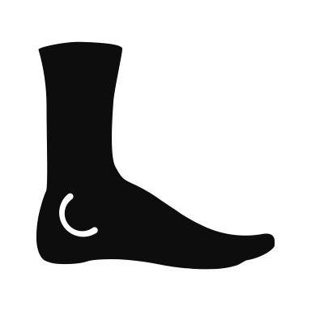


But this has been shown with exercise and with animals, not with aphasia.
Higher intensity
(Therapy over a short time)

Slide 13
Higher intensity
(Therapy over a short time)
Lower intensity
(Therapy spread out)

Slide 14
Lower intensity
(Therapy spread out)

Slide 15

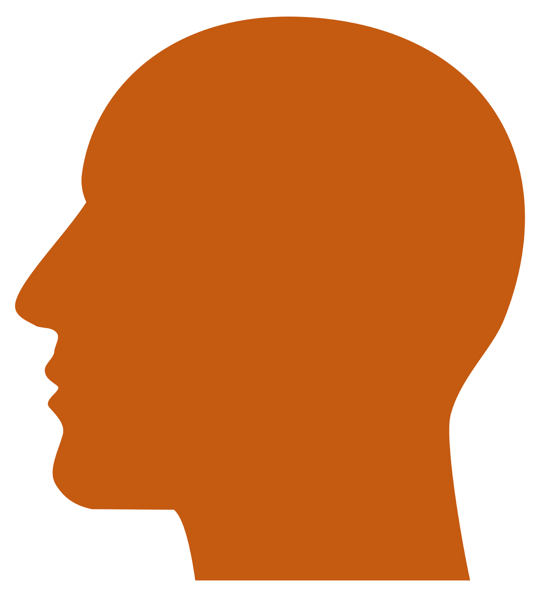

Spreading out therapy matches what we know about learning:
Lower intensity
(Therapy spread out)

Slide 16

repeating things over a longer time helps you learn better.
Lower intensity
(Therapy spread out)

Slide 18
We looked at studies that compared the same amount
of therapy spread out and closer together
Higher intensity
(over a short time)
Same amount of therapy
Lower intensity
(spread out)

Slide 19

Overall, there wasn’t a strong difference. But, we only found a few papers to look at.
Higher intensity
Lower intensity

Slide 20
Hours per week
Importantly, all of the treatments did work, from 3 hours a week to 15 hours a week.
0
✓
✓
✓
✓
✓
✓
✓
✓
✓
✓
3
15
Notes:
Research has shown that speech pathologists and patients both rank this very highly in questions that need answering. We want to know, is it better to do a certain amount in a shorter space of time or a longer space of time?
* We know from multiple surveys that outpatients, and therefore most chronic aphasia pts, receive 1-3 hrs per week, whereas * high intensity research…
Can be a sense of guilt amongst clinicians about this gap because "everybody knows" higher intensity is better

Slide 21


We need some bigger studies to answer this question.
Higher intensity
(Therapy over a short time)
Lower intensity
(Therapy spread out)

Slide 22

But there are other things that are important for therapy.
Higher intensity
Lower intensity

Slide 23
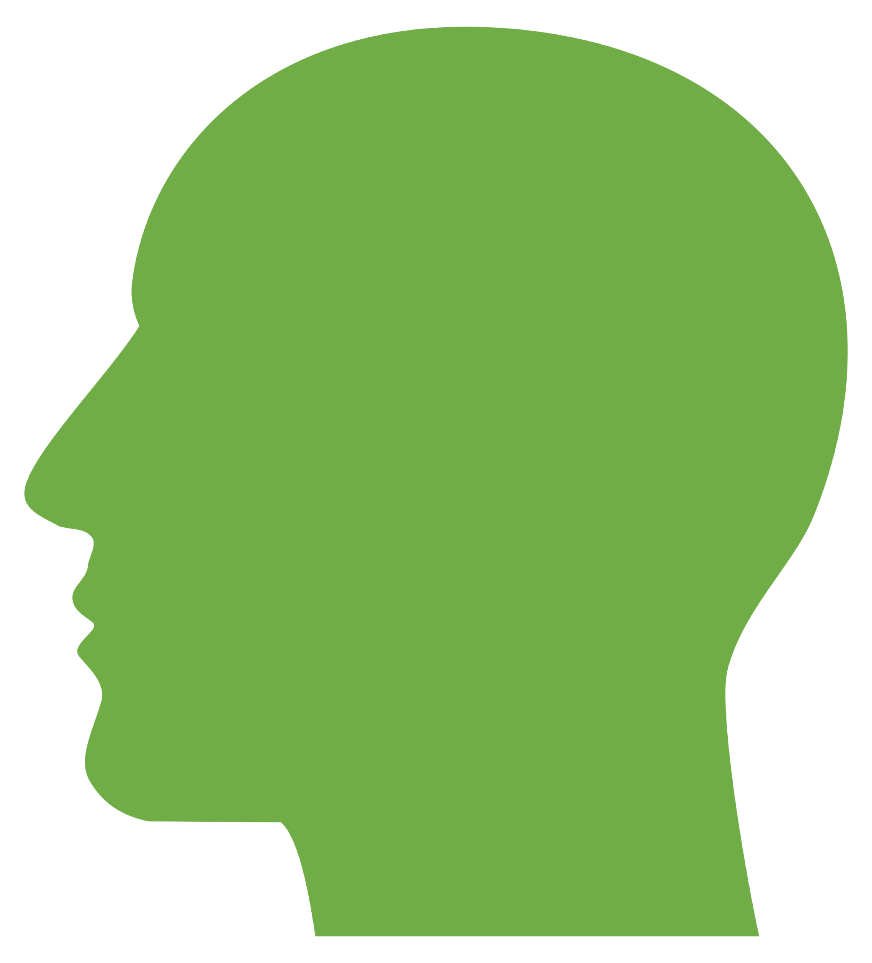





The right timing for therapy might also depend on things like your mood, endurance, how much support you have, and your motivation.
Motivation
Family support
Mood
Higher intensity
Lower intensity
Endurance

Slide 24
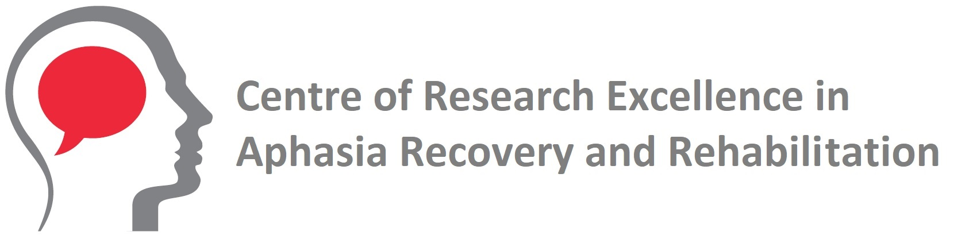
Comparing higher and lower weekly treatment intensity for chronic aphasia: A systematic review and meta-analysis.
John E. Pierce
Robyn O’Halloran
Maya Menahemi-Falkov
Leanne Togher
Miranda L. Rose

